Slide 1
What’s up with Tabby’s star?
A possible explanation.
Presentation at Max Planck Institute for Astronomy, 3/6/19.
Yashodhan Manerikar,
Indian Institute of Technology Madras and Inter-University Centre for Astronomy and Astrophysics.

Slide 2
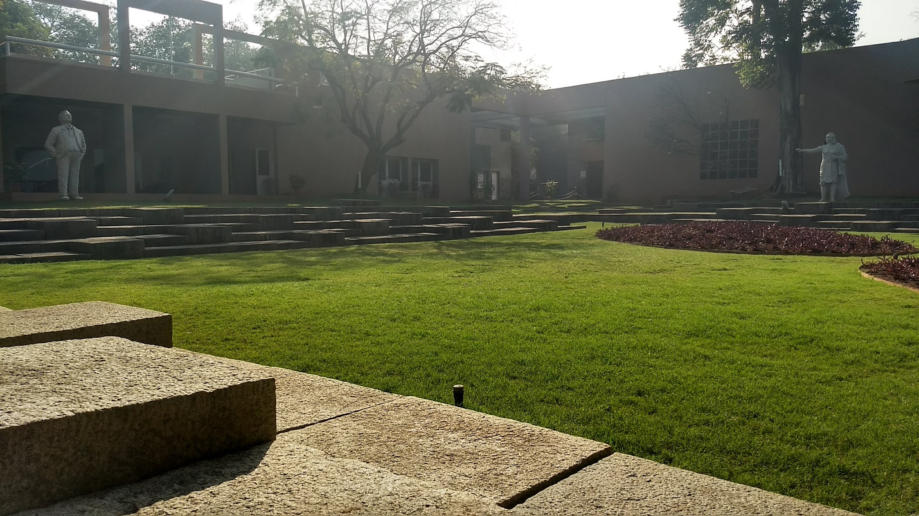

The research was done under the supervision of Prof. Sanjit Mitra at the Inter-University Center for Astronomy and Astrophysics (IUCAA), Pune, India.

Slide 3
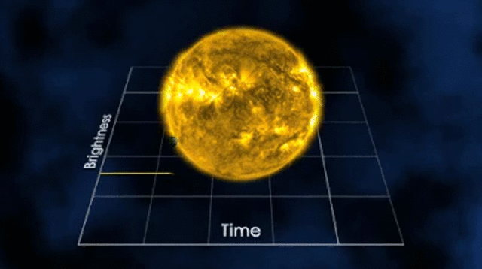
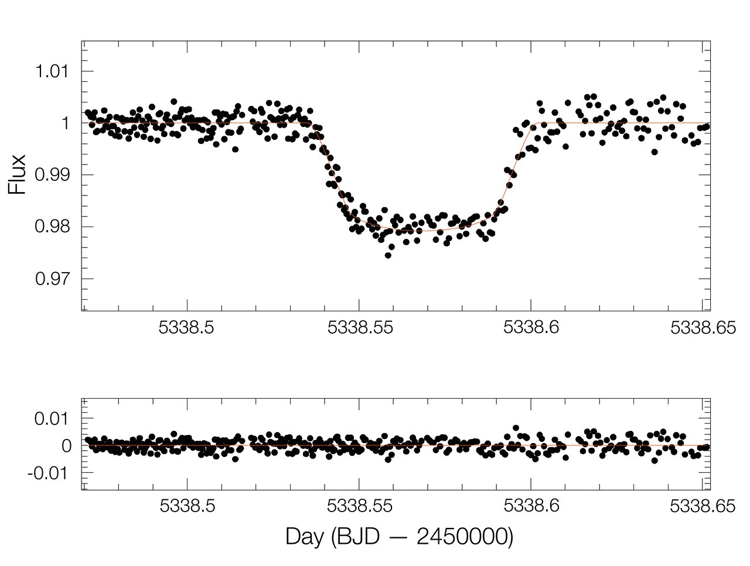
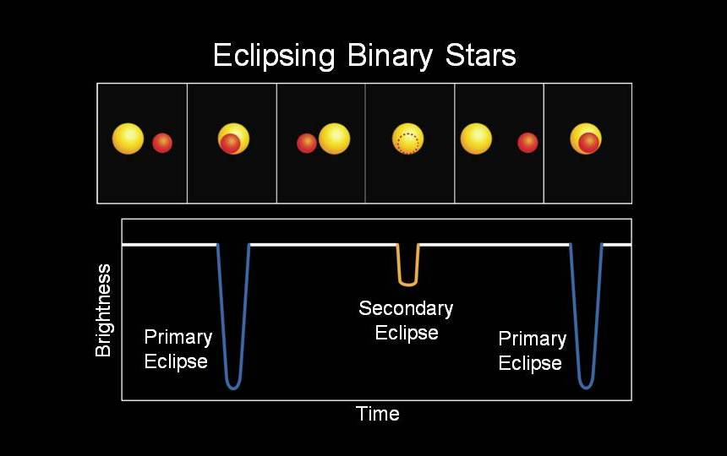
The Kepler space telescope recorded the photometric data of ~150000 stars for ~4.25 years.
More than 2600 exoplanets were detected with this data.
It is also possible to detect binary systems with the Kepler data.
Lightcurve of a typical exoplanet transit (c.ESO)
A binary system lightcurve

Slide 4
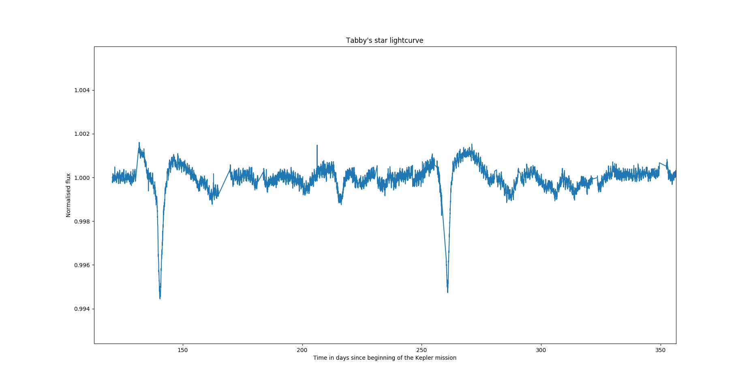
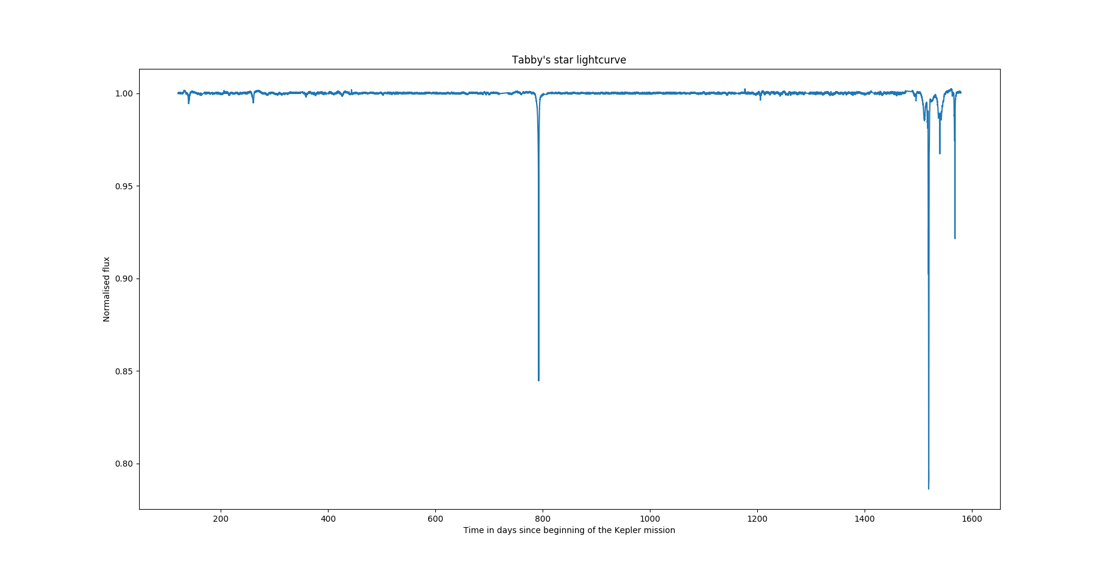
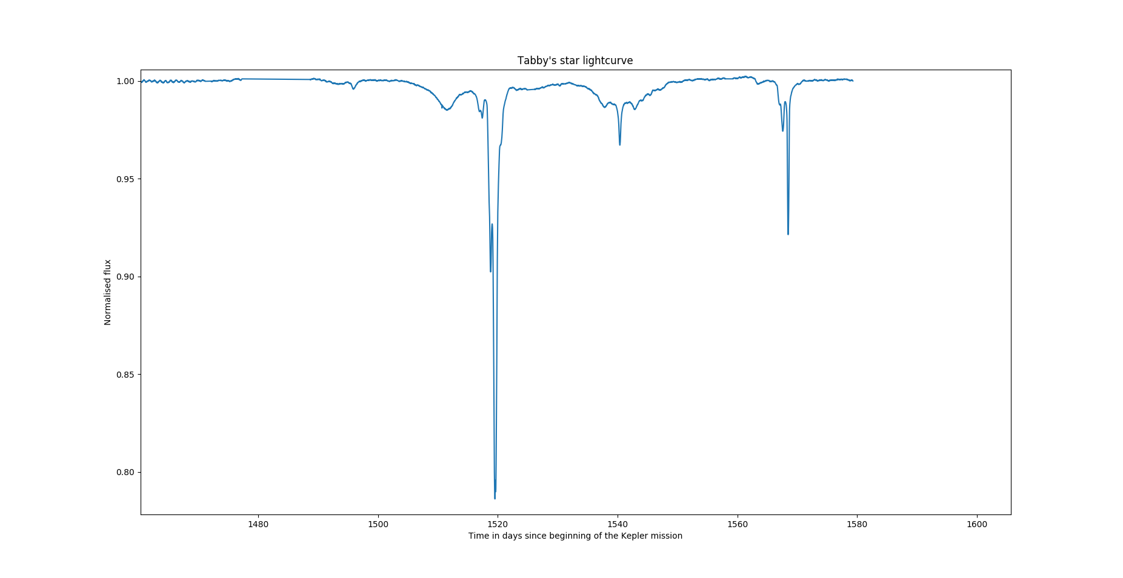
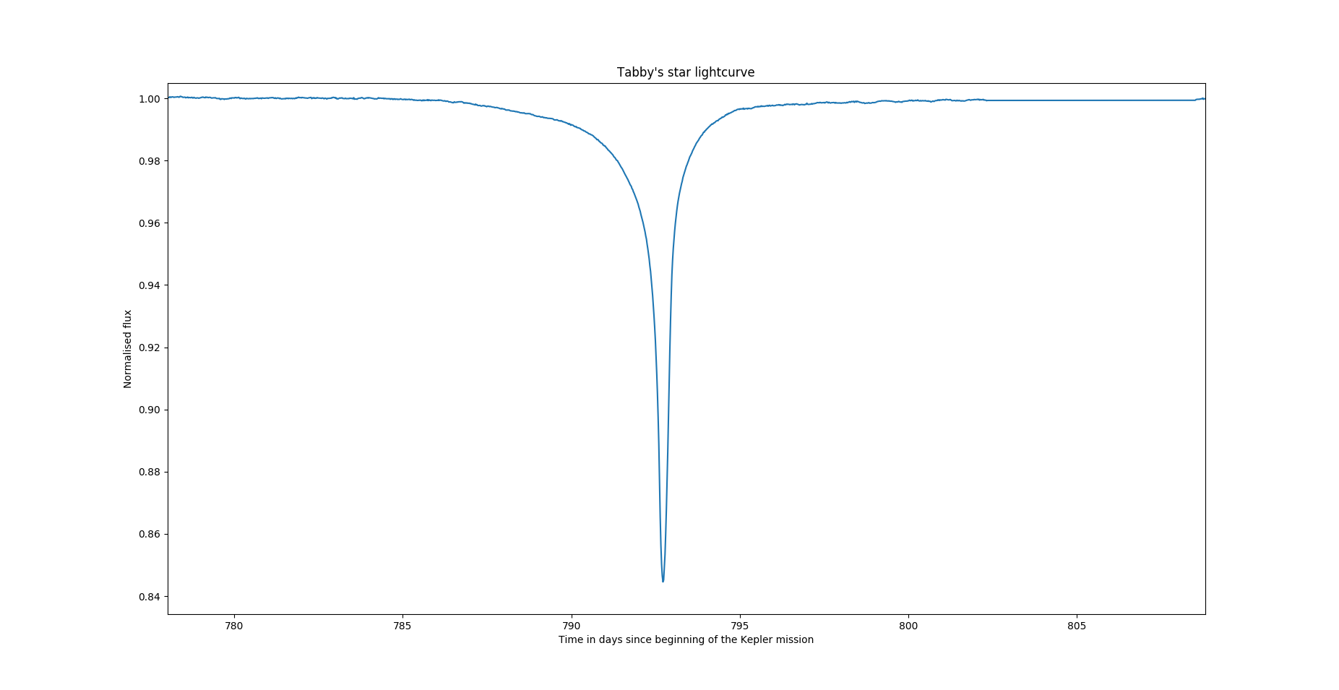
And here comes KIC 8462852! AKA Tabby’s star, AKA WTF star (Boyajian et al, 2016).
It is an F type star with magnitude 12.

Slide 5
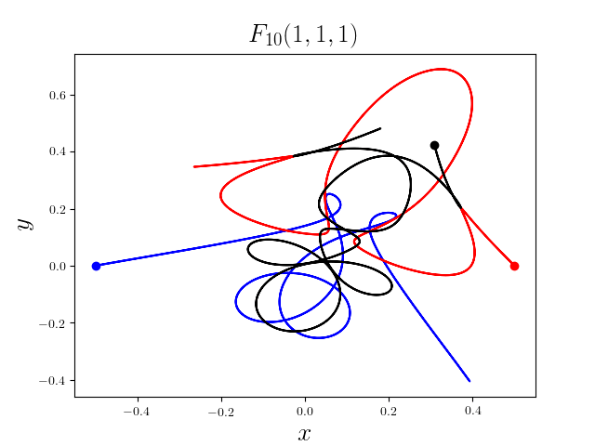
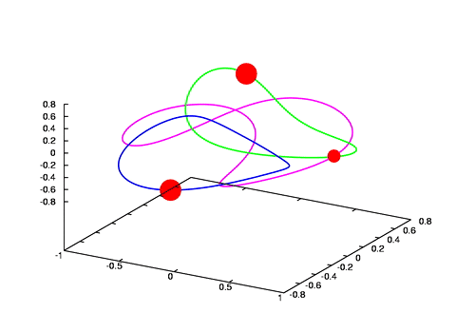
Speculated explanations so far: Dust ring, comets, intrinsic variability and aliens.
A possible explanation? A trinary star system.
The 3-body problem does not have exact solutions except for Lagrange points in the case of systems that have a massive central body.
However, trinary star systems are not uncommon and there exist periodic solutions found numerically.

Slide 6
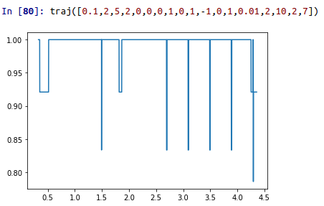
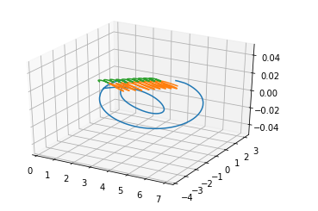
Simulations exist for exoplanets, binary stars, single dips etc. Hence I had to write my own simulation.
Simulation input: initial positions, initial velocities, masses, radii and luminosities of 3 stars (27 parameters).
Simulation output: lightcurve based on the motion of these stars for the Kepler period.
I have not yet added limb darkening, but will soon incorporate it.
Fitting: with lower parameters (Frame of reference of one of the stars, constraints on luminosity for the 22% dip, constraint on velocities to be coplanar); with Particle Swarm Optimisation.
Example of the code.

Slide 7
Goal: To find a fit for the entirety of 4.25 years of Kepler mission and predict the next dips.
Consideration: Two main sequence stars and a dwarf/compact star.
Coplanar motion.
Angle between the plane and the line of sight must not be large.
Challenges and concerns: Large number of parameters , hence very slow optimisation.
PSO is an unpredictable algorithm, amount of time taken by the code is not at
all proportional to the cost.
Must try different kinds of trinary systems, and try introducing mathematical
constraints for periodic orbits.

Slide 8
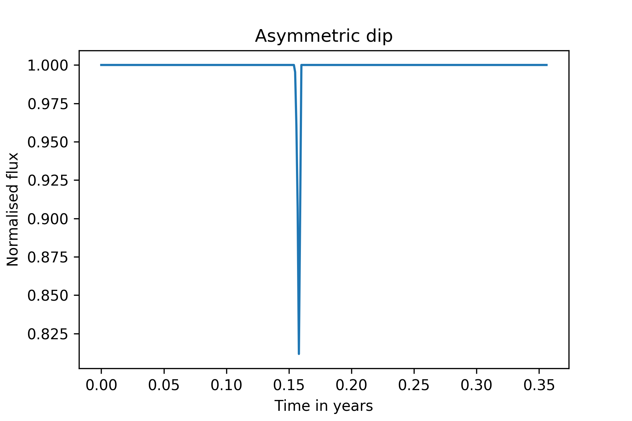
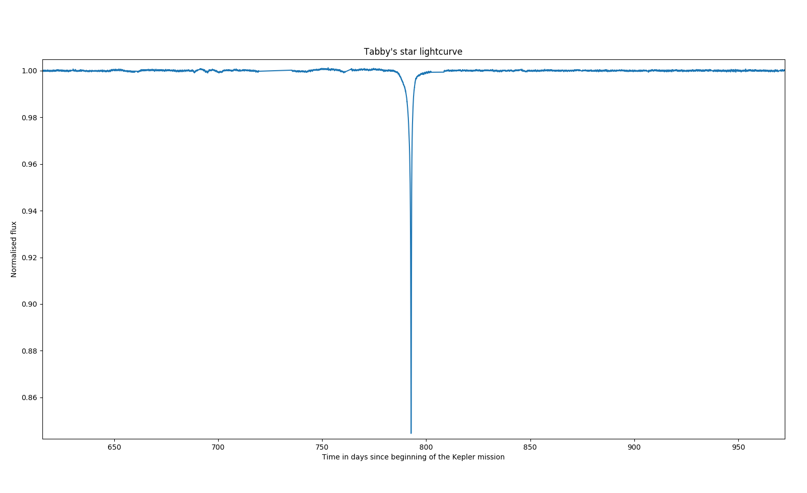
Results:
After essentially looking at thousands of fits manually, I have found some local fits that show similar characteristics as the Tabby’s star. I have not found a complete fit, so it cannot be conclusively said that tabby’s star is a trinary system yet it can be said that such peculiar dips can be produced by chaotic motion of 3 stars. With a better code and computer, it might be possible to find a complete fit.
Simulated vs Observed (will look better with limb darkening)

Slide 9
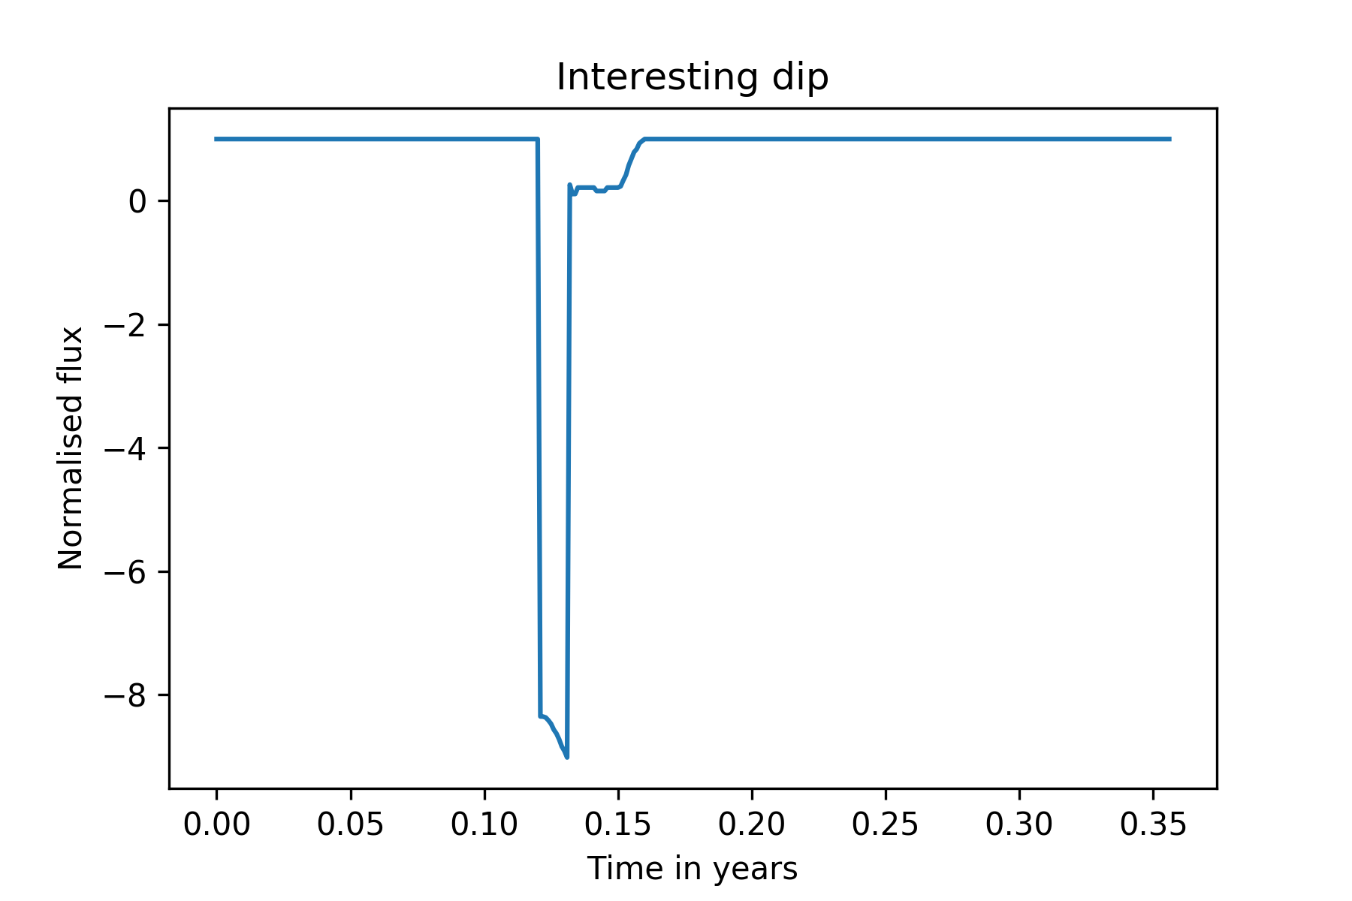
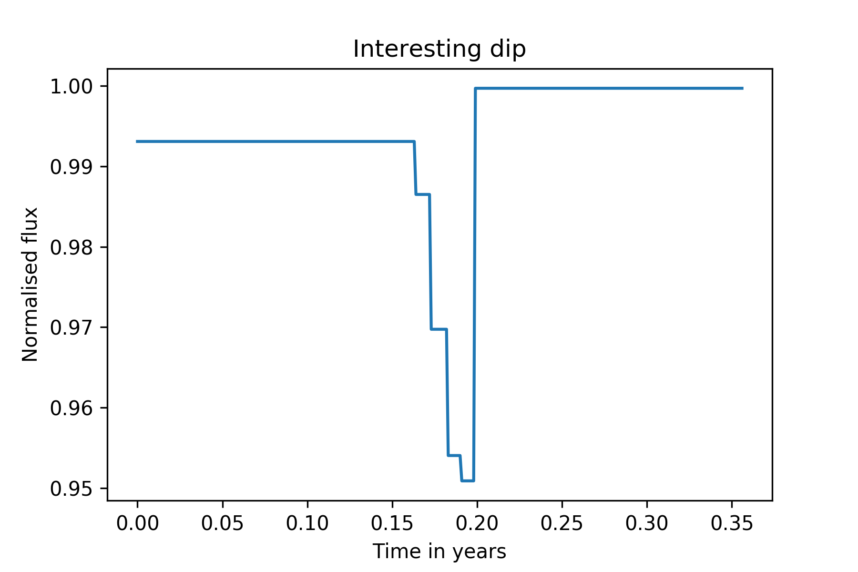
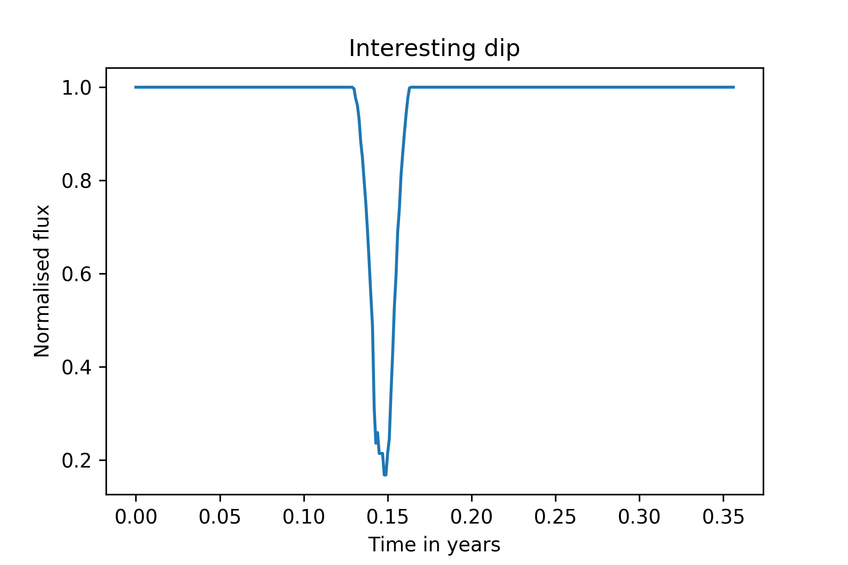
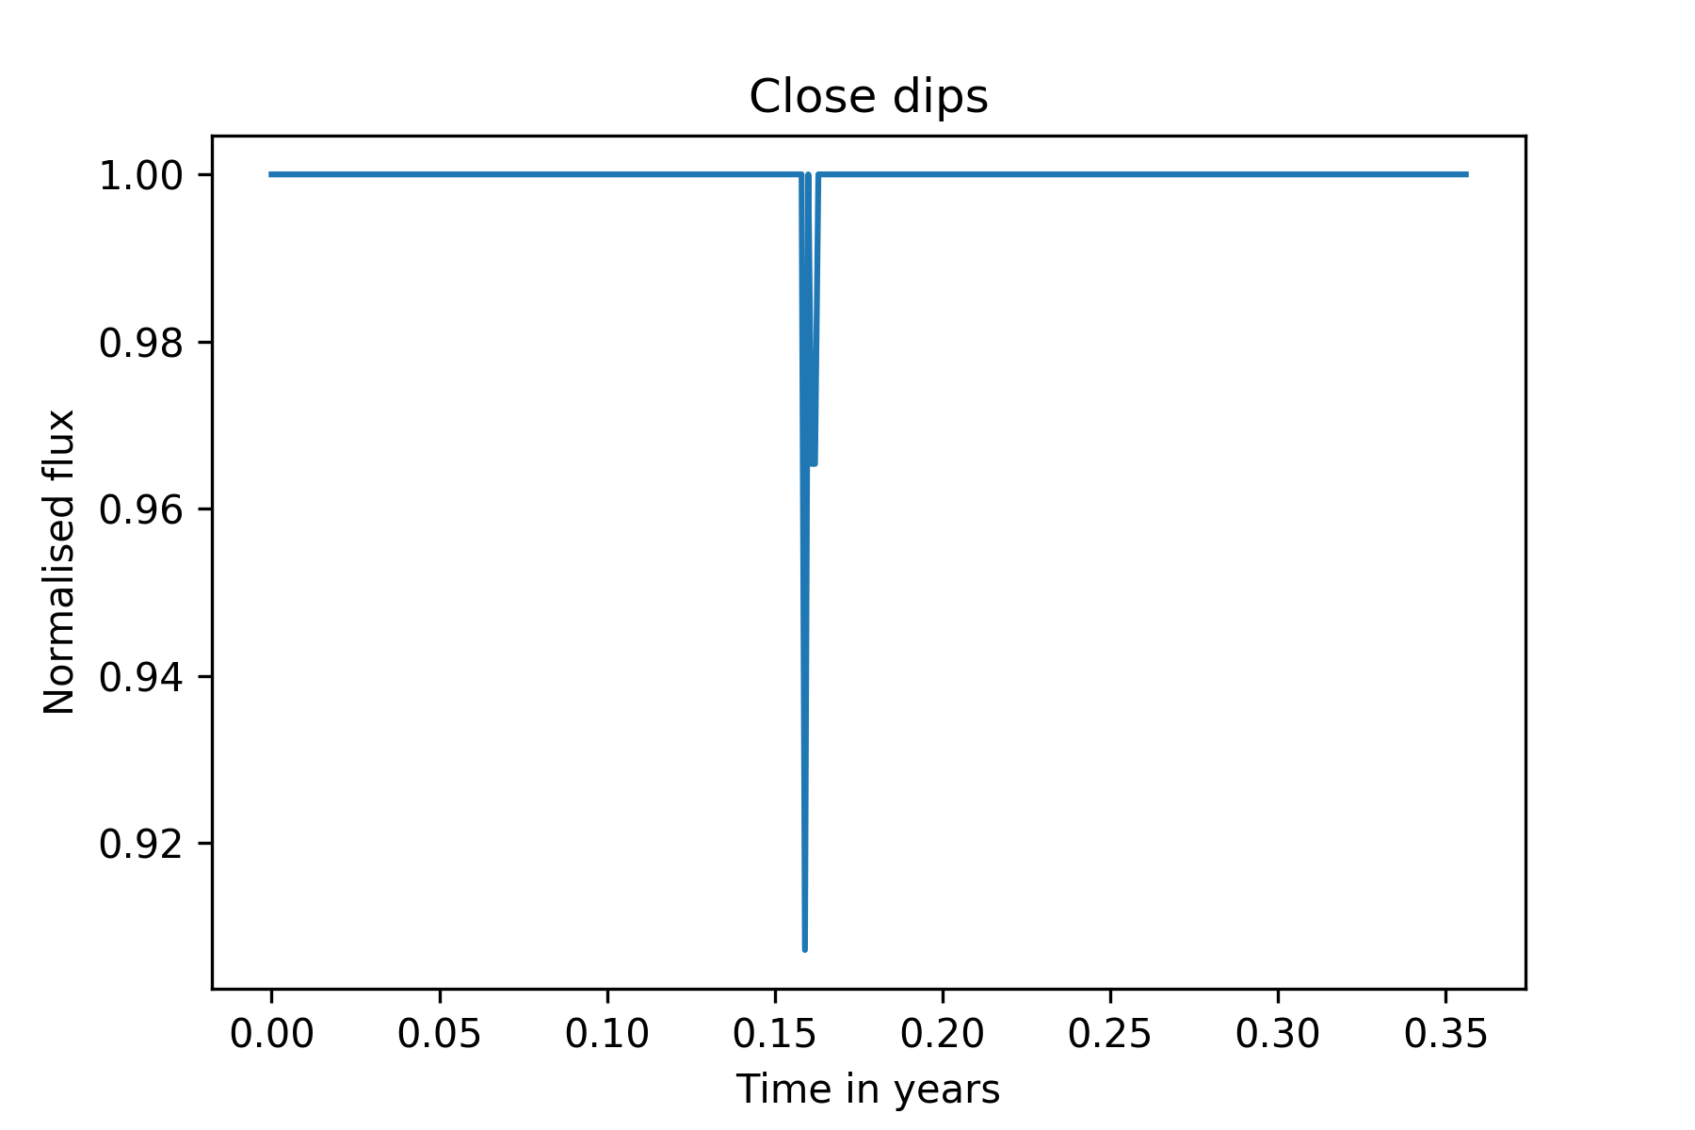

Slide 10
Future?
Trying harder and using different approaches will help fetch better results.
Looking at the radial velocity data taken by Andre Mueller, MPIA.
TESS will observe the star for one month and the data will be available by ~October. Ideally it will be great if a fit predicts the next dip accurately.

Slide 11
THANK YOU FOR COMING!

